Slide 1


UE19CS204 – Web Technologies Mini Project
WEB APPLICATION FOR A SPORTS CLUB
3’B’
BHOOMIKA P BHAVIMATH : PES2UG19CS091
DURGALAKSHMI.V : PES2UG19CS120
ESHA H : PES2UG19CS122
GITHUB LINK:https://github.com/DURGALAKSHMI0108/WEB-TECHNOLOGIES-PROJECT-PES2UG19CS-091-120-122-3B-.git

Slide 2

BRIEF OUTLINE
ABSTRACT
TECHNOLOGIES USED
NEW FEATURES LEARNT
MEMBER CONTRIBUTIONS

Slide 3

ABSTRACT
This web page is designed to effectively and efficiently manages various activities of our Sports Club. The two core activities of the Sports Club i.e. leisure playing and coaching. Every person requires membership to access the facilities provided by the club. All sports enthusiasts are open to view and access the facilities provided by this website.
All client-side and server-side scripting is done in JavaScript in NODE JS
All client-side programming is done using REACT-JS library
Server-side scripting is done through EXPRESS-JS API.
.

Slide 4
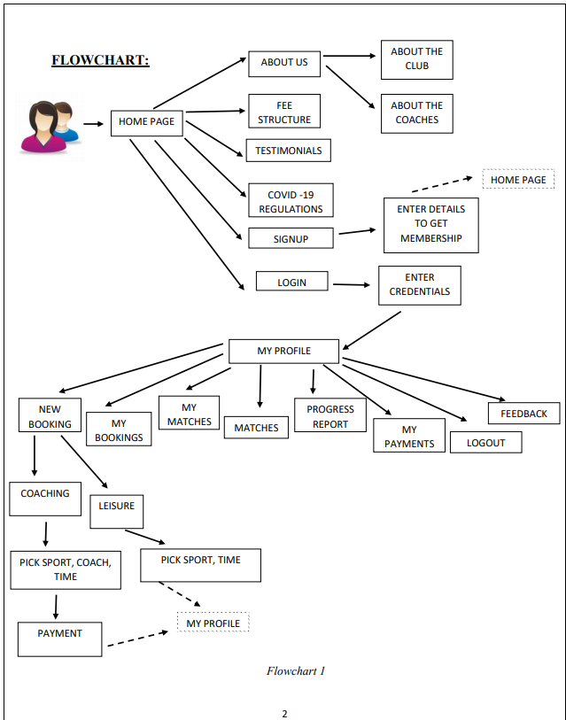
.

Slide 5
TECHNOLOGIES USED
REACT JS LIBRARY FOR CODING ALL FRONT-END DOCUMENTS
EXPRESS JS API TO CODE THE SERVER
MONGODB DATA BASE FOR STORING DETAILS ABOUT MEMBERS, COACHES, BOOKINGS
NODEJS ENVIRONMENT WAS USED TO RUN ALL THESE JS FILES
TO NAVIGATE TO DIFFERENT REACT COMPONENTS ,REACT ROUTER <LINK> WAS USED
TO SEND DATA FROM CLIENT TO SERVER, FORM TAG WAS USED
WE SET THE ACTION ATTRIBUTE AND SENT ALL FORM DATA TO THE SERVER

Slide 6
TECHNOLOGIES USED
PUG AS TEMPLATE ENGINE TO RENDER FEW HTML PAGES TO CLIENT (SEND DATA FROM EXPRESS SERVER TO HTML PAGES)
BODY-PARSER TO GET ALL FORM DATA FROM THE USER AND TO SAVE IN DATA BASE
COOKIE-PARSER TO SAVE LOGIN ID AND PASSWORD IN REQ.COOKIES TO ENSURE EASY RETRIEVAL OF INFORMATION IN THE PERSONALIZED PAGE

Slide 7
NEW FEATURES LEARNT
COMPONENT ‘STAR RATING ‘ FROM REACT-STAR-RATING MODULE TO GET RATINGS OF THE SPORTS CLUB
COMPONENT ‘CAROUSEL‘ FROM REACT-RESPONSIVE-CAROUSEL MODULE TO CREATE A SLIDE SHOW FOR TESTIMONIALS PAGE
DATE-AND-TIME MODULE TO GET CURRENT DATE & TIME
PATH MODULE TO SET AND HANDLE FILE PATHS
LEARNT MANY ATTRIBUTES OF INPUT TAG(PATTERN,REQUIRED)
USED RESPONSE.REDIRECT FUNCTION TO REDIRECT TO REACT COMPONENT ONCE PROCESSING IN SERVER WAS DONE

Slide 8
ESHA H
DURGALAKSHMI.V
BHOOMIKA P
TO BOOK FOR NEW COACHING
TO ENROLL FOR A MATCH
LATEST MATCH BOOKED
SHOW LATEST BOOKINGS IN SPORTS CLUB
LATEST PAYMENT
HOME PAGE
ABOUT THE CLUB
FEE STRUCTURE
LOGOUT
SIGN UP PAGE
TO BOOK FOR LEISURE PLAYING
ABOUT THE COACHES
COVID19 REGULATIONS
FEEDBACK
TESTIMONIALS
LOGIN PAGE

Slide 9
THANK YOU !!

